Slide 1
Customer Shopping Behaviour Analysis
Insights into Spending Patterns, Segmentation, and Product Preferences
~ Yashwardhan Shinde

Slide 2
Problem Statement
A leading retail organization seeks to gain deeper insights into customer shopping behavior to enhance sales performance, customer satisfaction, and long-term loyalty. Recent shifts in purchasing patterns across demographics, product categories, and sales channels have created a need for data-driven understanding.
The management team aims to identify the key factors—such as discounts, customer reviews, seasonal trends, and purchasing preferences—that influence buying decisions and repeat purchases.
Business Question: How can consumer shopping data be leveraged to uncover actionable trends, strengthen customer engagement, and optimize marketing and product strategies?

Slide 3
Project Overview
Project Objective & Scope
Objective: To analyze transactional data from 3,900 customer purchases to understand shopping behavior.
Goal: To identify key insights related to spending patterns, customer segmentation, and purchase behavior.
Scope: The analysis covers customer demographics, product preferences, discount usage, and subscription behavior.
Outcome: To generate data-driven insights that support strategic decision-making, improve customer engagement, and optimize marketing and product strategies.

Slide 4



Methodology & Tech Stack
Technology Stack
Python (Pandas): Performed data cleaning, handled missing review ratings, and created engineered features for analysis.
SQL (PostgreSQL): Conducted structured queries to analyze revenue patterns,customer demographics, and shipping trends.
Power BI: Developed interactive dashboards to enable visual storytelling and business insight communication.
This Photo by Unknown Author is licensed under CC BY-SA

Slide 5
Dataset Summary
Data Volume: 3,900 customer transaction records across 18 well-defined attributes, enabling both behavioral and demographic analysis.
Customer Demographics: Includes age, gender, location, and subscription status, supporting segmentation and targeted insights.
Purchase Characteristics: Covers product item, category, purchase amount, size, color, season, and shipping type to understand buying preferences.
Behavioral Indicators: Tracks discount usage, purchase frequency, previous purchases, and review ratings to evaluate customer engagement.
Data Quality & Cleaning: Identified 37 missing values in the Review Rating column and applied median imputation at the category level to preserve analytical accuracy.
Analysis Readiness: Dataset was cleaned, standardized, and structured to support Python SQL, and Power BI–based analysis.

Slide 6
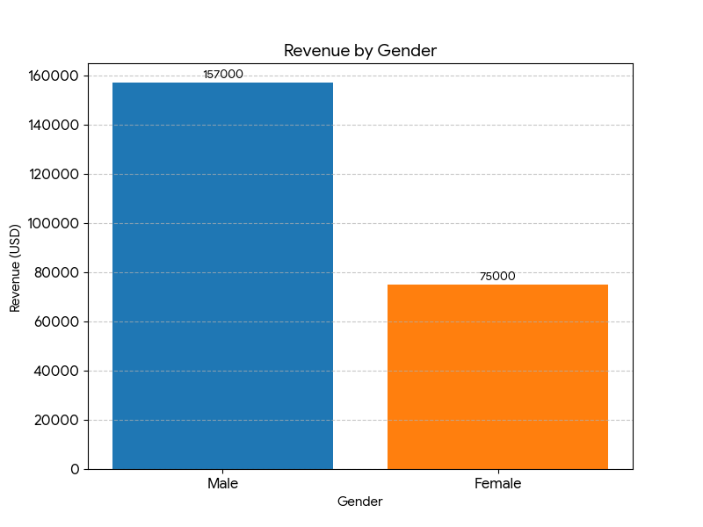
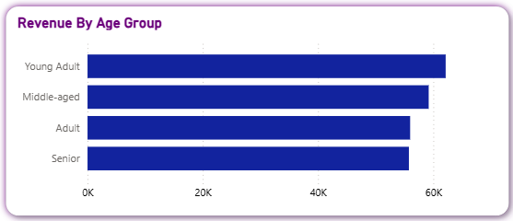
Demographics & Revenue
Gender Gap: Male customers generate significantly higher revenue (₹157K) compared to female customers (₹75K), indicating a strong gender-based spending difference.
Age Group Performance: Young Adults emerge as the highest revenue-contributing segment, reflecting strong purchasing power and engagement.
Revenue Trend: Middle-aged customers follow closely behind Young Adults, making them the second most valuable revenue segment.

Slide 7
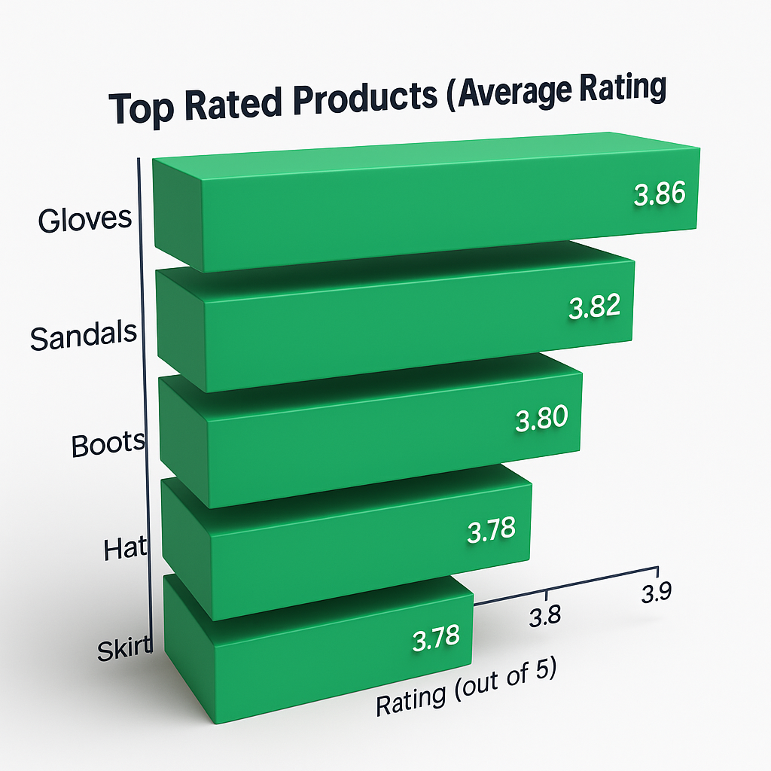
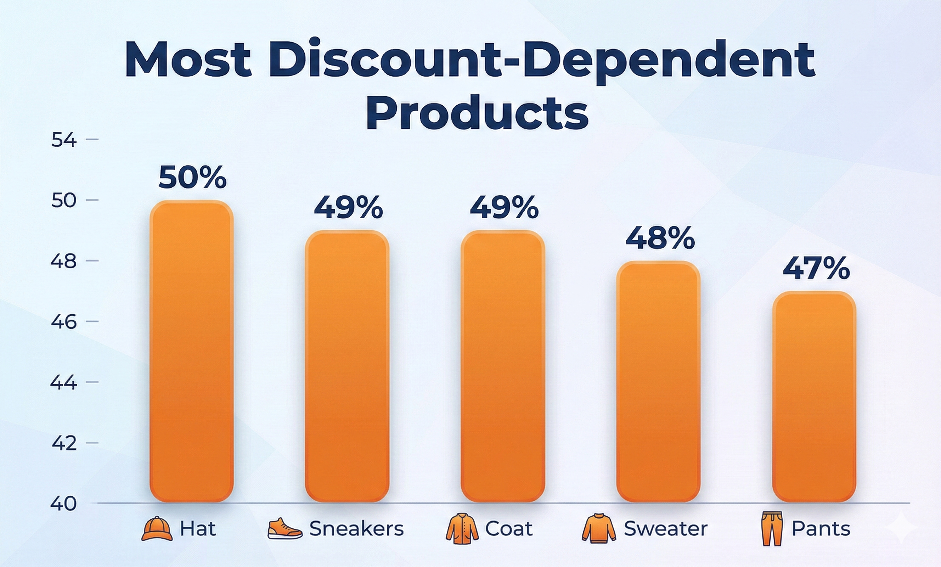
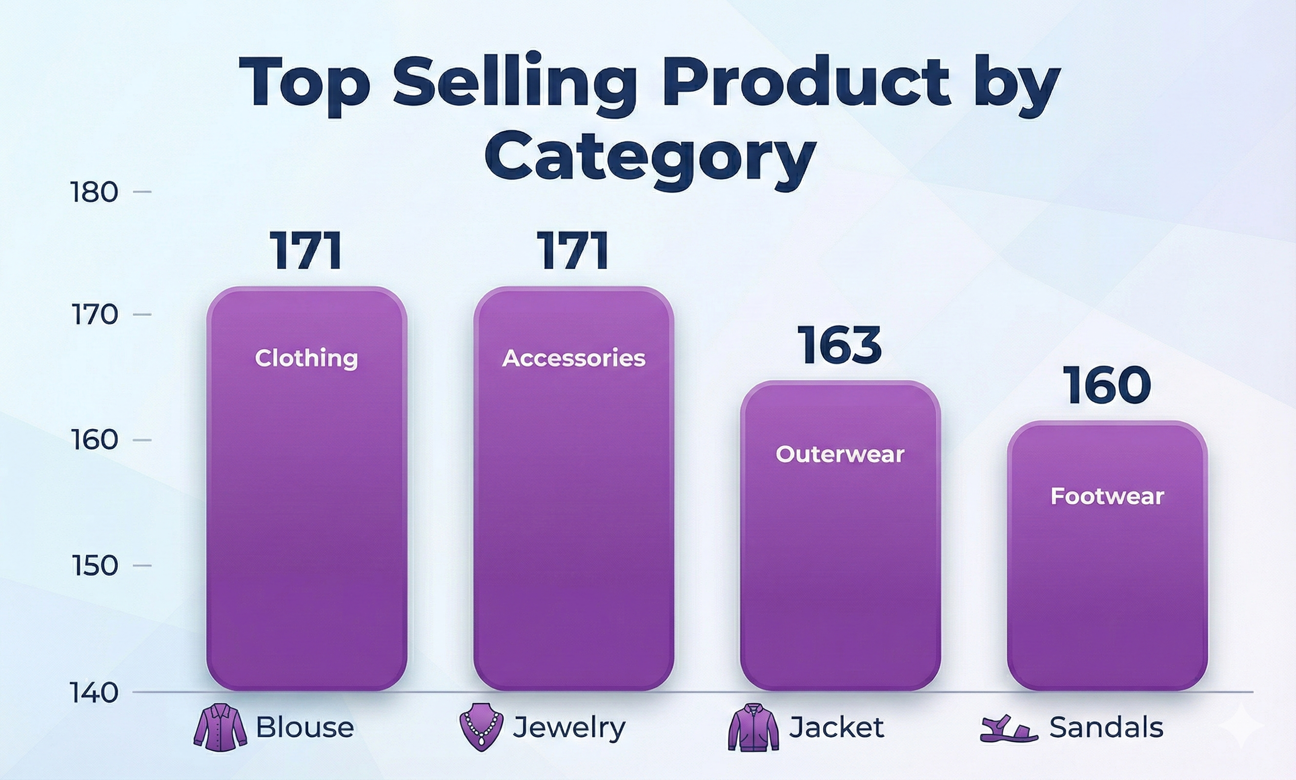
Product Performance Insights
Top-Rated Products: Gloves (3.86), Sandals (3.84), and Boots (3.82) receive the highest average customer ratings, indicating strong product satisfaction.
Discount Dependency: Hats and Sneakers show high price sensitivity, with nearly 50% of purchases driven by discounts.
Category Leaders: Blouse leads Clothing, Jewelry dominates Accessories, and Sandals perform best in Footwear based on sales volume.

Slide 8
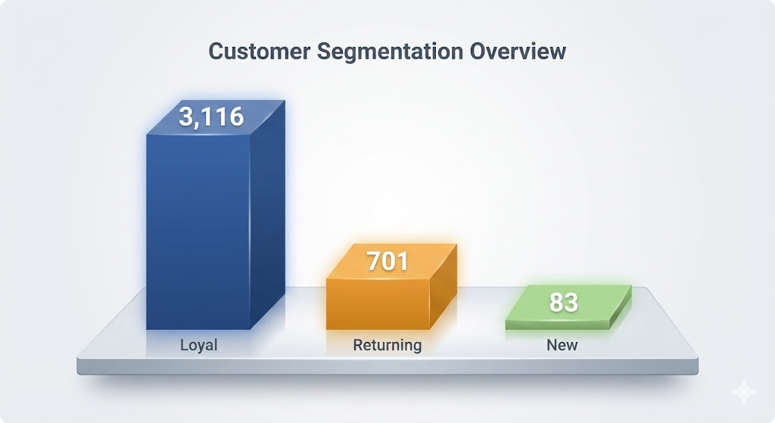
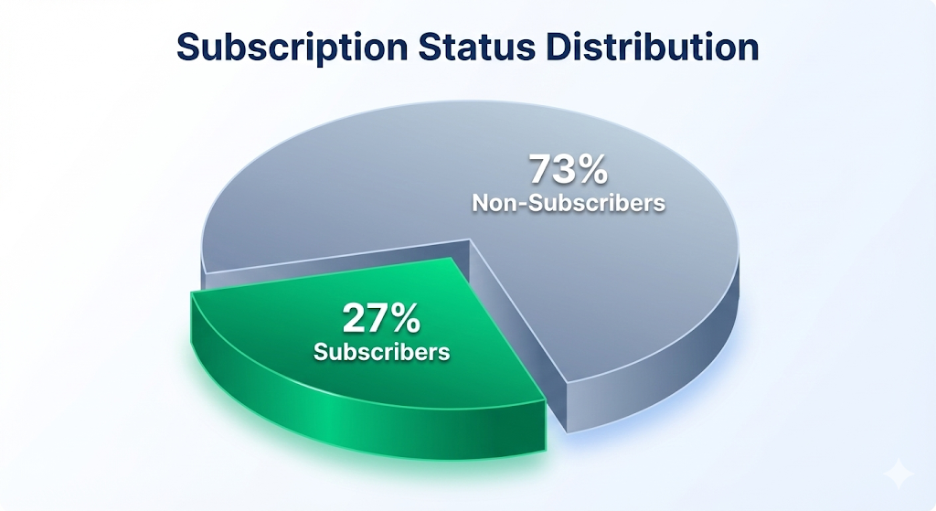
Customer Segmentation
Customer Segments: The customer base is primarily composed of Loyal customers (3,116), followed by Returning (701) and New customers (83).
Subscription Split: Only 27% of customers are subscribers, while 73% remain non-subscribers, indicating significant growth potential for subscriptions.
Key Insight: Despite lower individual engagement, non-subscribers contribute the majority of total revenue due to their larger volume.

Slide 9
Shipping & Shopping Trends
Shipping Value: Customers opting for Express shipping show a higher average spend ($60.48) compared to Standard shipping users ($58.46), indicating stronger purchase intent.
High-Value Discount Users: Identified a segment of customers who use discounts yet maintain above-average basket values, highlighting opportunities for targeted promotions.
Seasonality Coverage: The analysis includes purchases across Spring, Summer, Fall, and Winter, enabling seasonal trend and demand pattern evaluation.

Slide 10
Business Recommendations
1. Boost Subscriptions: Promote exclusive benefits to convert non-subscribers.
2. Loyalty Programs: Incentivize 'Returning' customers to become 'Loyal'.
3. Targeted Marketing: Focus ad spend on Young Adults and high-value Male segments.
4. Product Positioning: Highlight top-rated items (Gloves, Sandals) in campaigns.

Slide 11
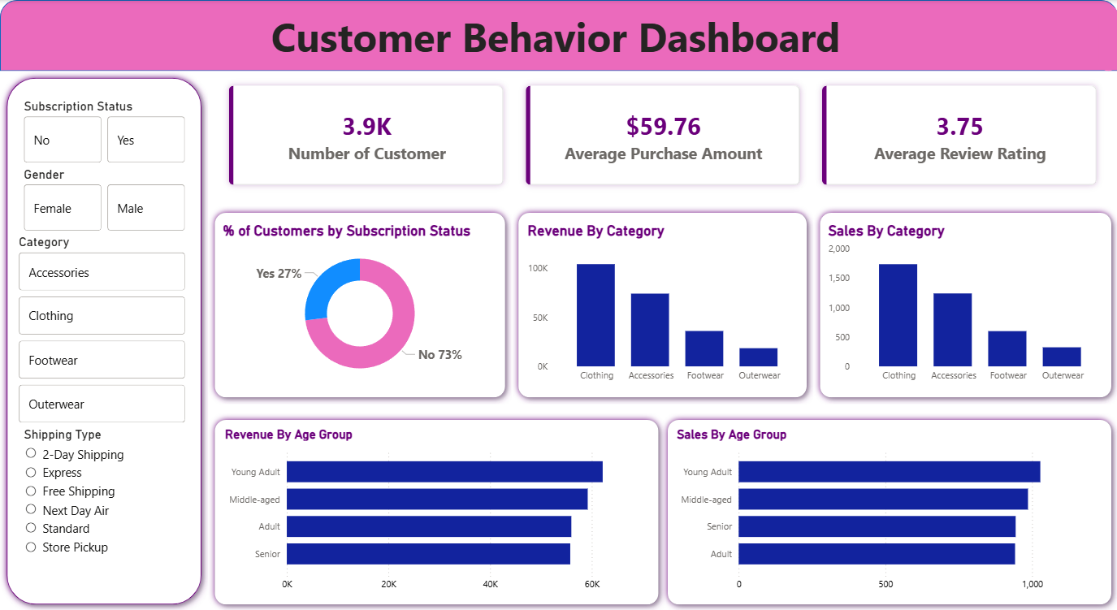
Interactive Power-BI Dashboard

Slide 12
Thank You
Questions & Discussion

